Slide 1
Parallel Sorting Algorithms

Slide 2
General Discussion
We will look at various sorting algorithms and how to apply the most suitable parallel techniques to them.
The worst case complexity of popular merge sort and the average time complexity of quick sort are both O(n log n).
The best parallel time complexity using p processors can be achieved is
Optimal parallel time complexity = O(n log n) / p = O(log n)
where p = n
In reality a O(log n) algorithm with n processors is not easy to achieve.

Slide 3
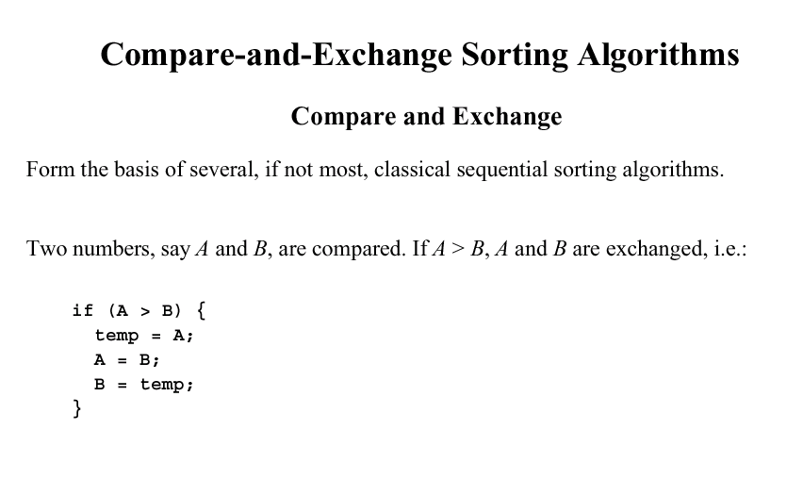

Slide 4
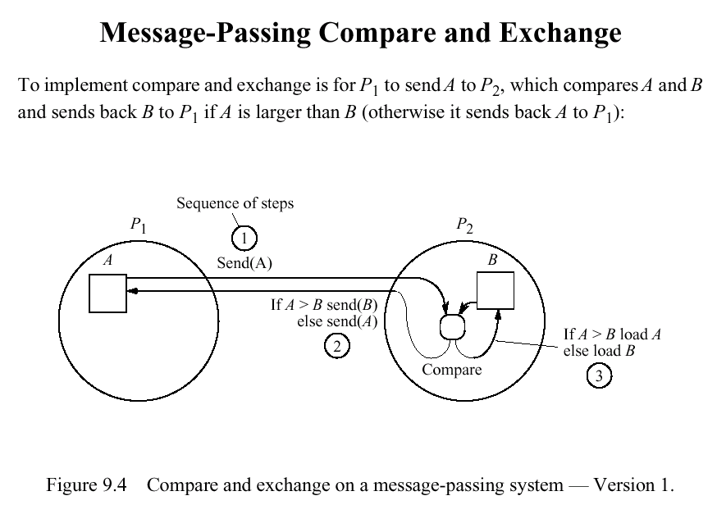

Slide 5
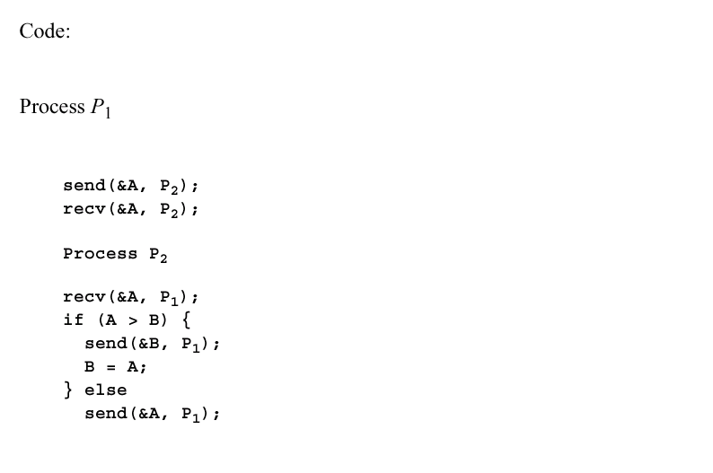
Pseudo code for compare & Exchange

Slide 6
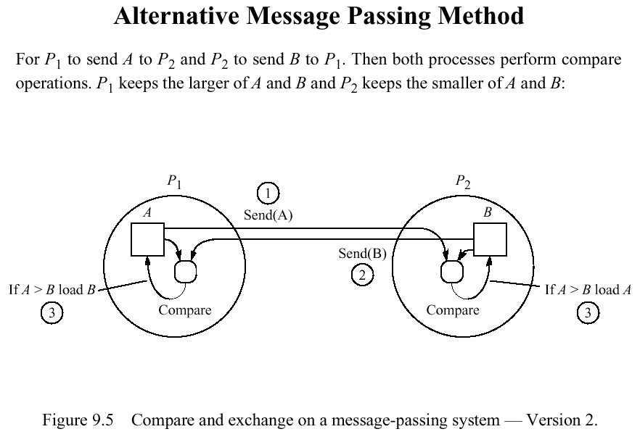

Slide 7
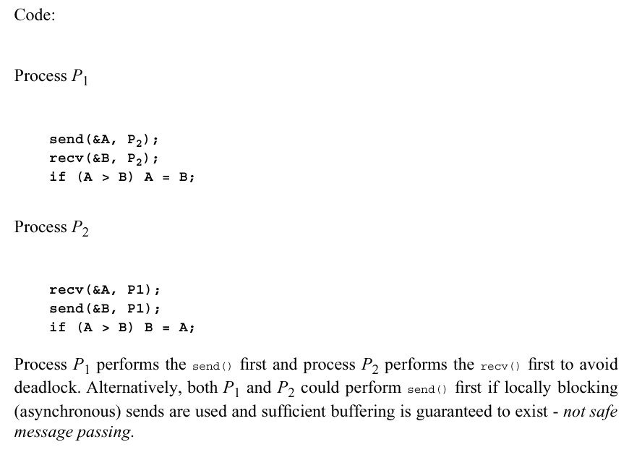

Slide 8
Data partitioning
Normally there would be many numbers than processors.
Normally a group of numbers are assigned to each processor.
For n numbers and p processors, n/p numbers would be assigned to each processor.

Slide 9
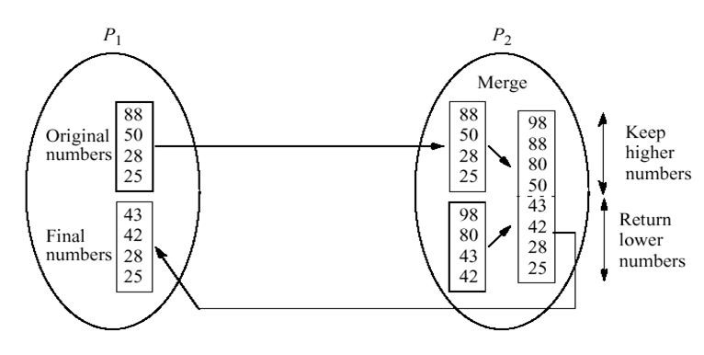
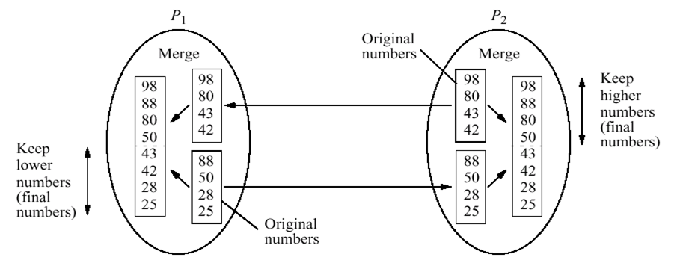

Slide 10







Bubble Sort

Slide 11
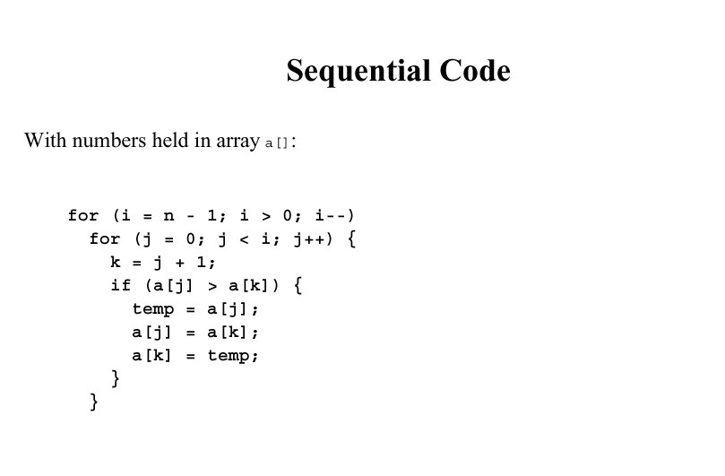

Slide 12
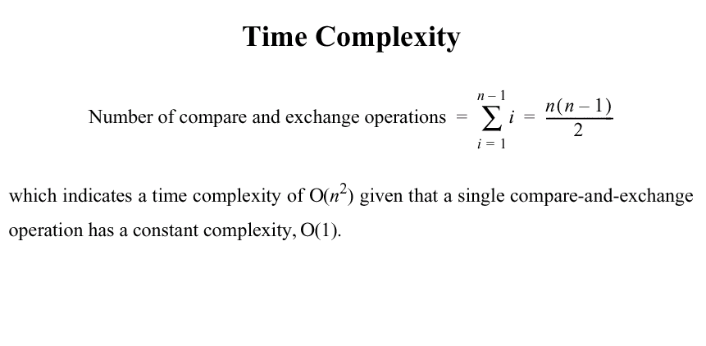

Slide 13
Odd-even transposition sort
Bubble sort is written as a purely sequential algorithm.
A variation of bubble sort called odd-even transposition sort operates in two alternating phases, an even phase and an odd phase.
  In the even phase, even-numbered processes exchange numbers with their right neighbours
  In the odd phase, odd-numbered processes exchange numbers with their right neighbours
Odd –even transposition sort reduces the time complexity to O(n).

Slide 14
Odd-even transposition sort
 | P₀ | P₁ | P₂ | P₃ | P₄ | P₅ | P₆ | P₇
Step
0 | 88 | 50 | 28 | 25 | 98 | 80 | 43 | 42
1 | 50 | 88 | 25 | 28 | 80 | 98 | 42 | 43
2 | 50 | 25 | 88 | 28 | 80 | 42 | 98 | 43
3 | 25 | 50 | 28 | 88 | 42 | 80 | 43 | 98
4 | 25 | 28 | 50 | 42 | 88 | 43 | 80 | 98
5 | 25 | 28 | 42 | 50 | 43 | 88 | 80 | 98
6 | 25 | 28 | 42 | 43 | 50 | 80 | 88 | 98
7 | 25 | 28 | 42 | 43 | 50 | 80 | 88 | 98

Slide 15
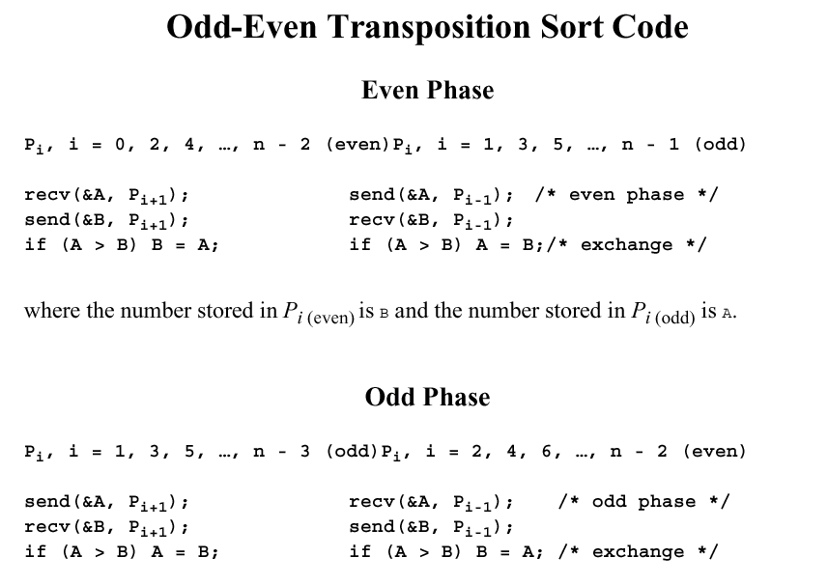

Slide 16
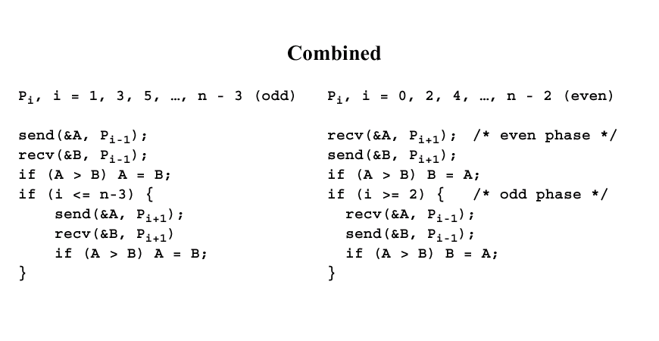

Slide 17
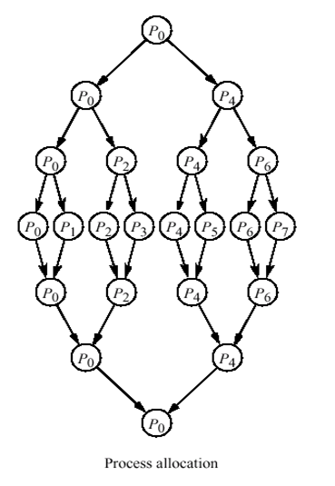
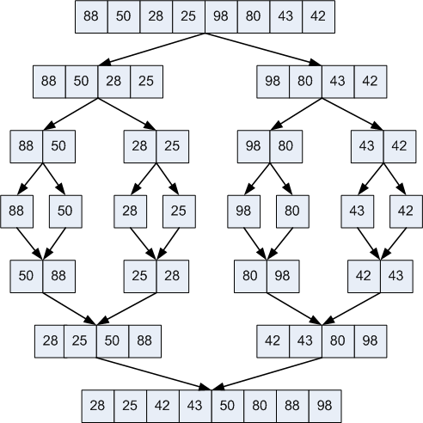
Merge sort

Slide 18
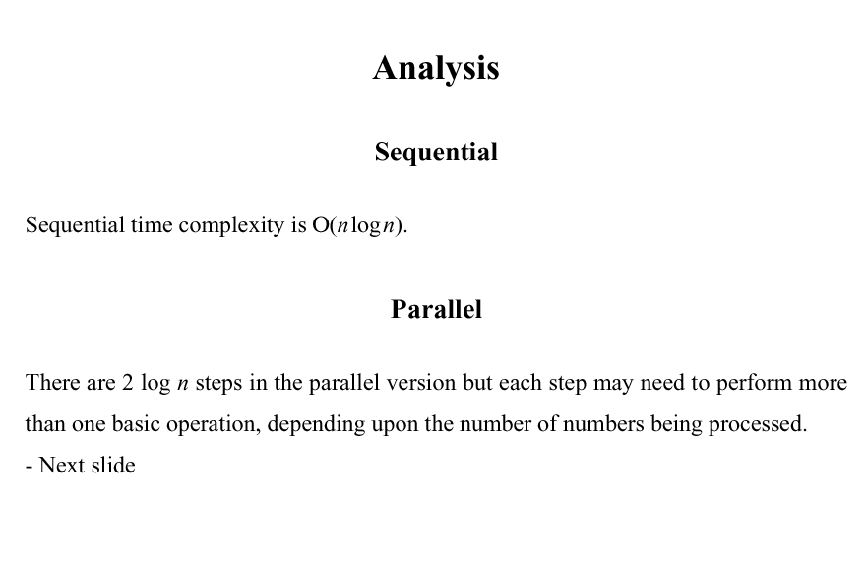

Slide 19
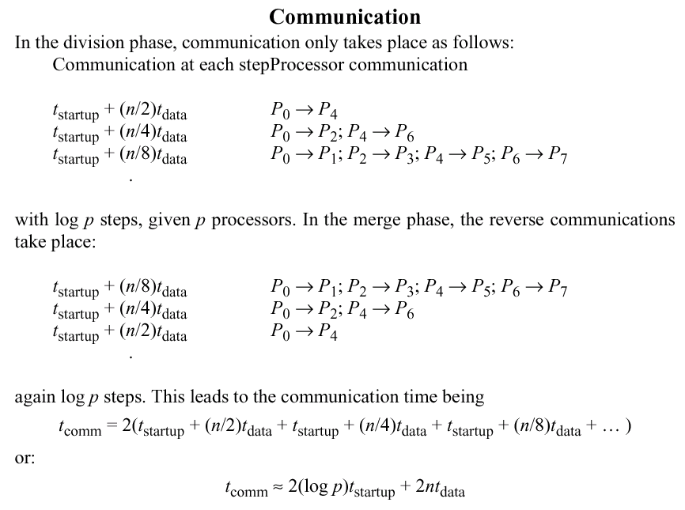

Slide 20
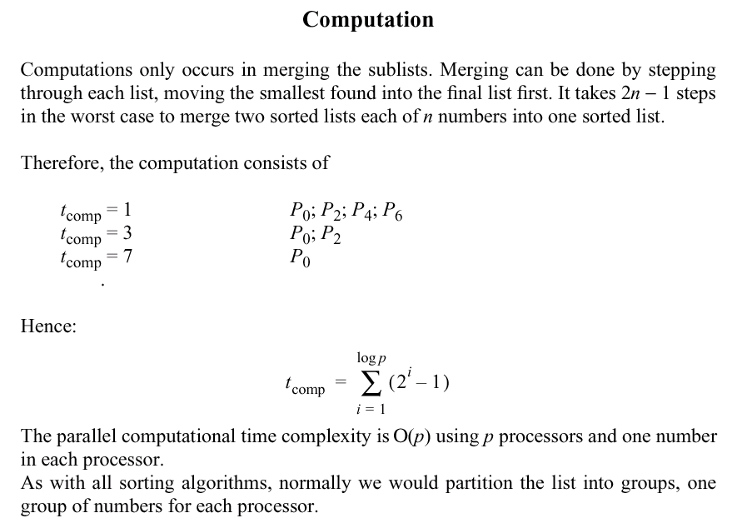

Slide 21
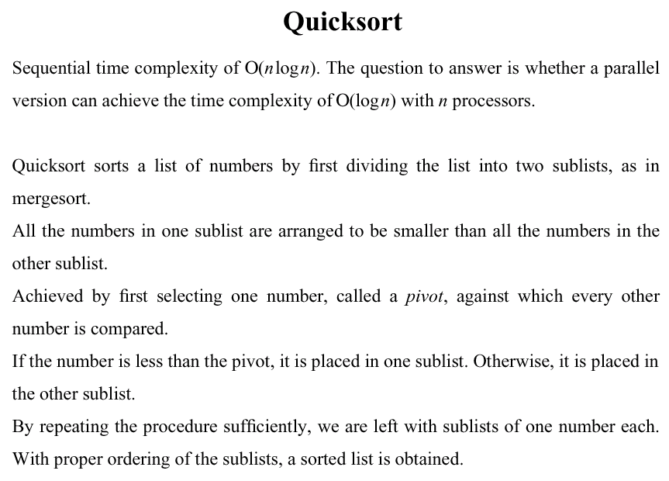

Slide 22
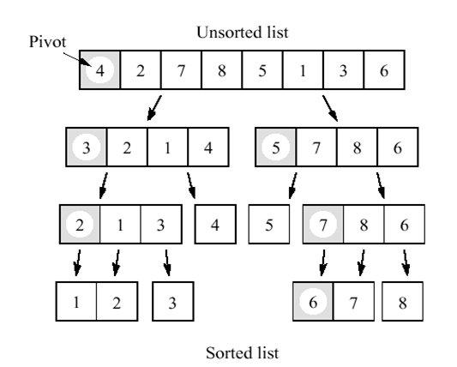
Sequential quick sort

Slide 23
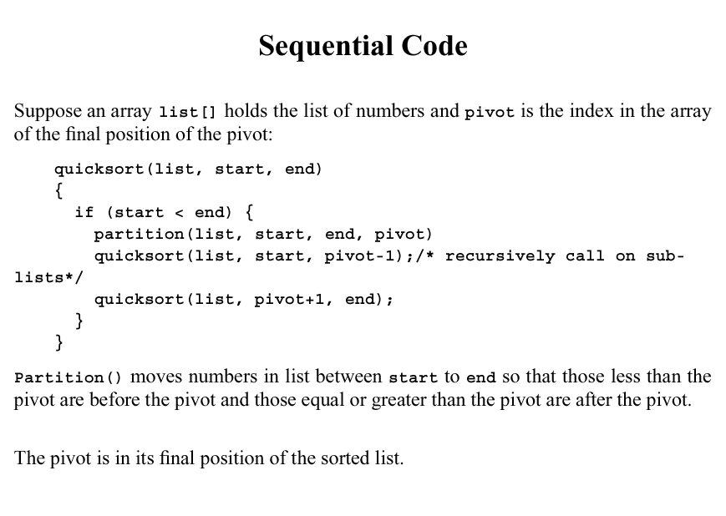

Slide 24
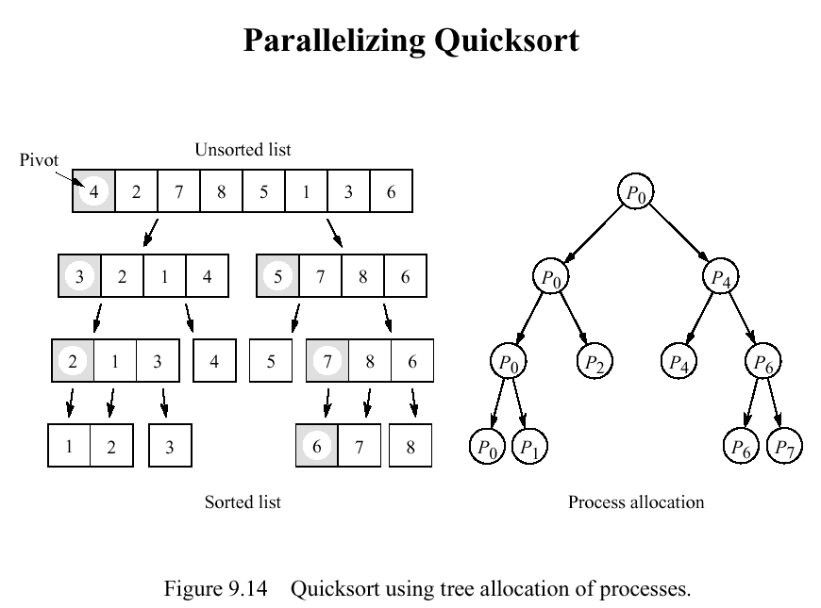

Slide 25
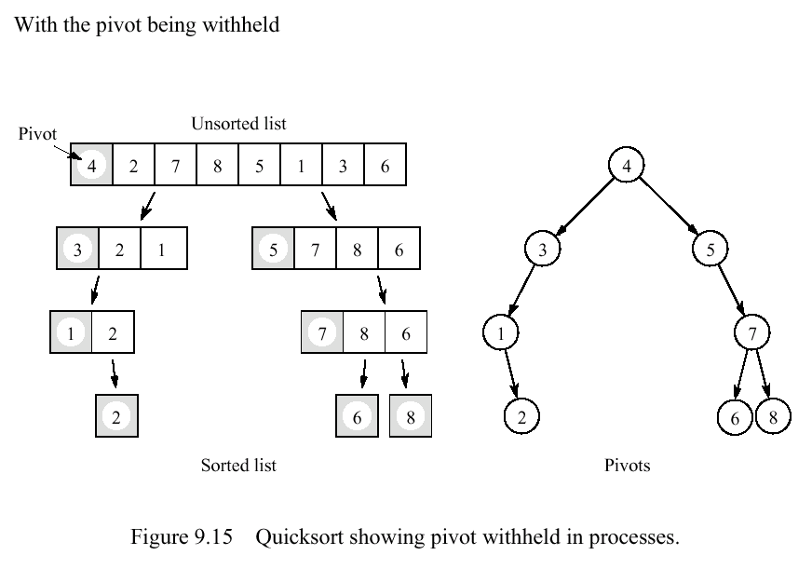

Slide 26
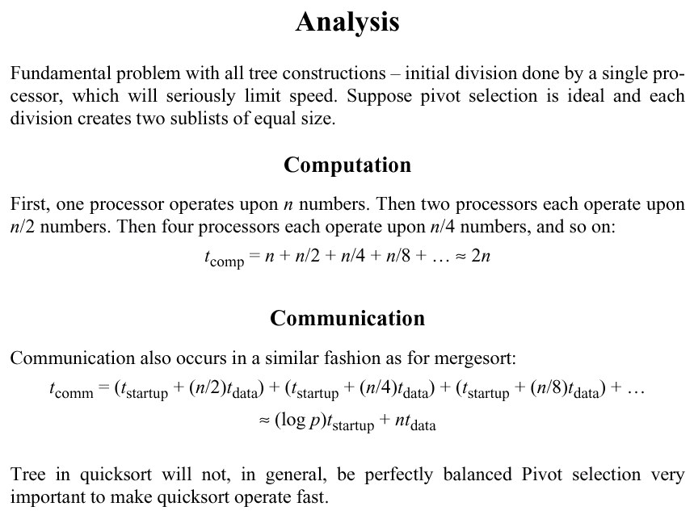

Slide 27
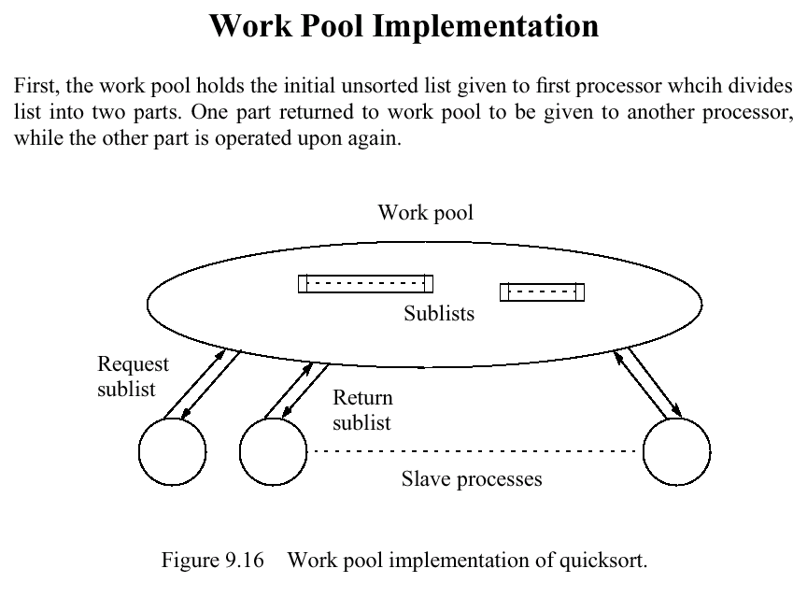

Slide 28
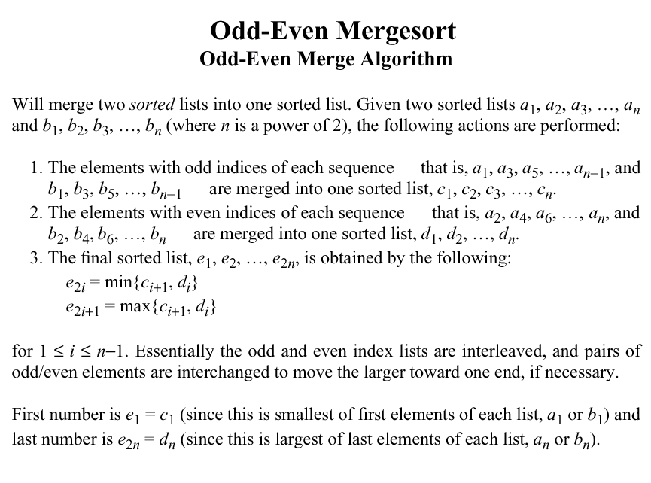

Slide 29
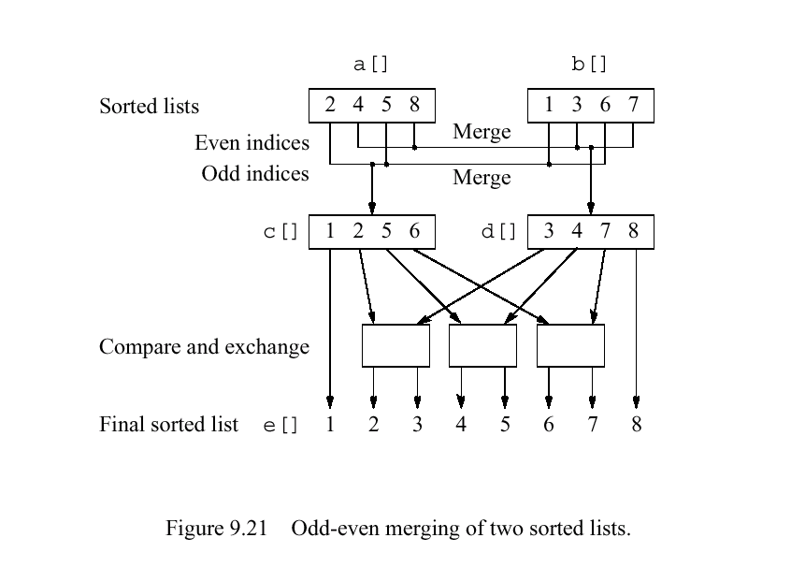

Slide 30
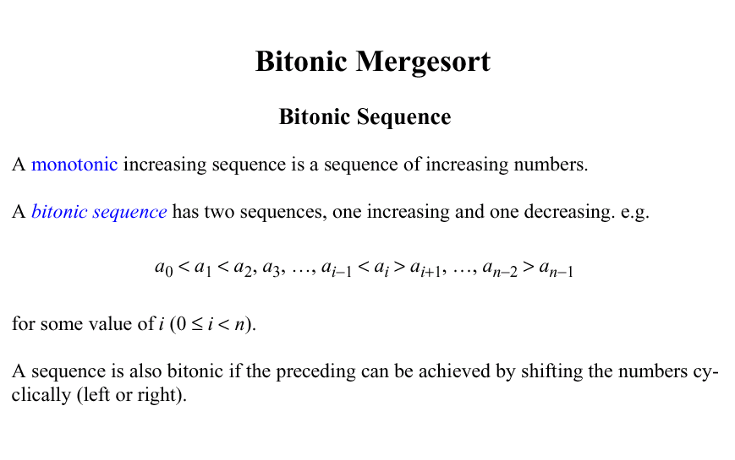

Slide 31
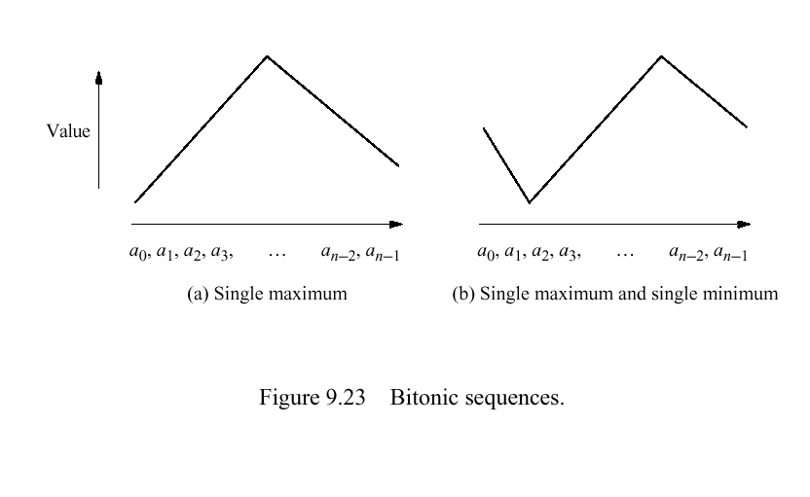

Slide 32
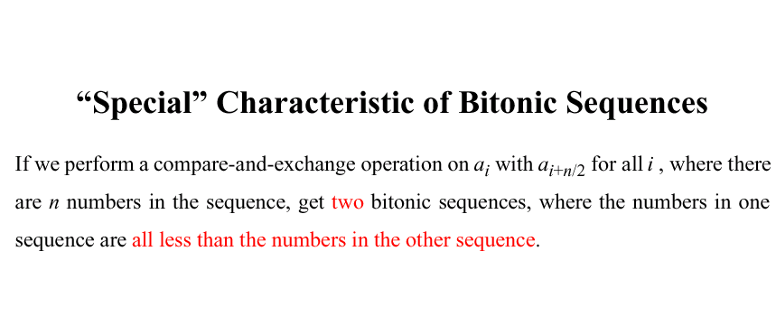

Slide 33
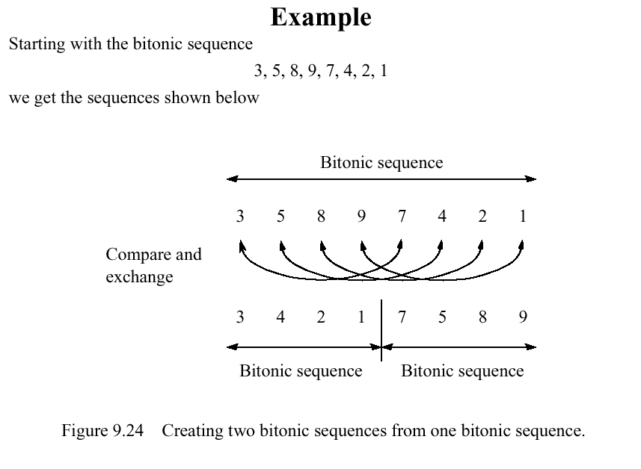

Slide 34
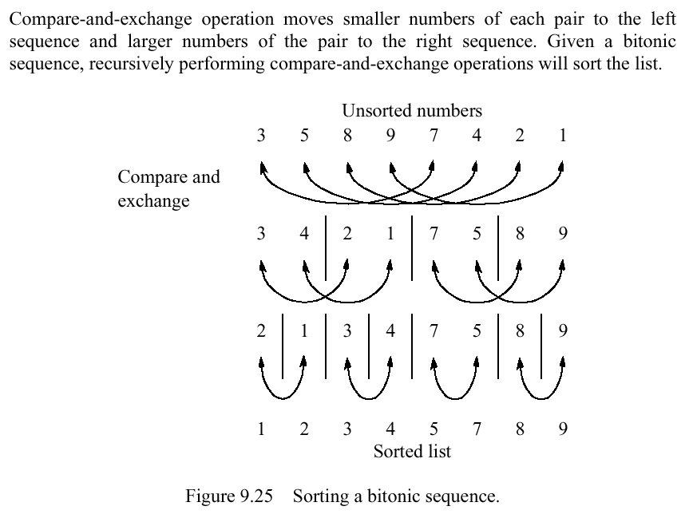

Slide 35
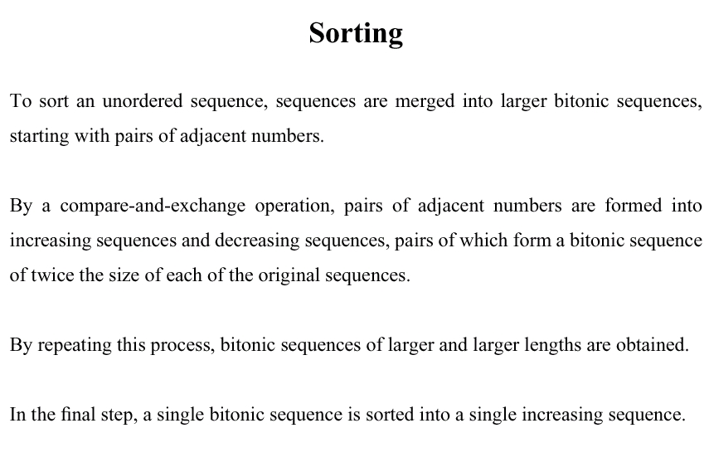

Slide 36
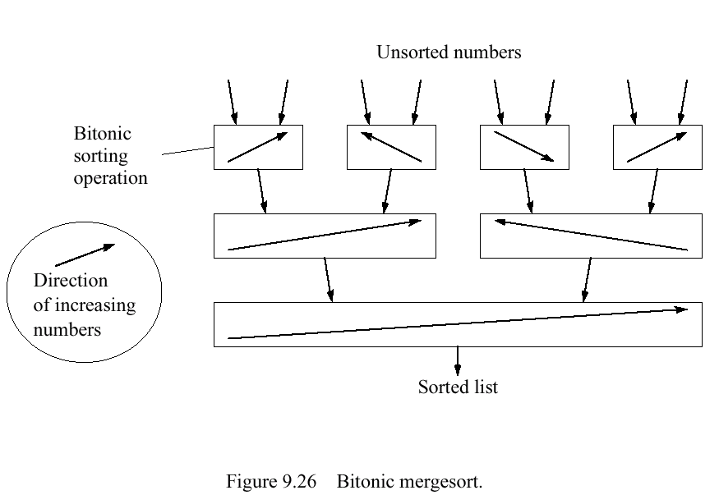

Slide 37
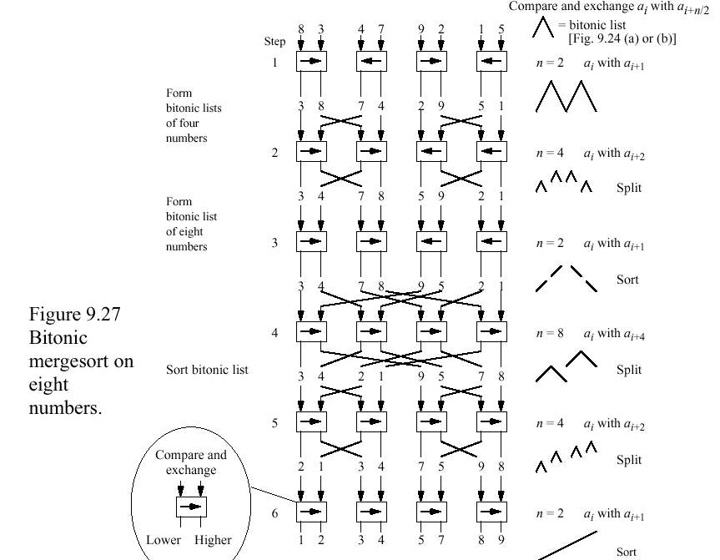

Slide 38
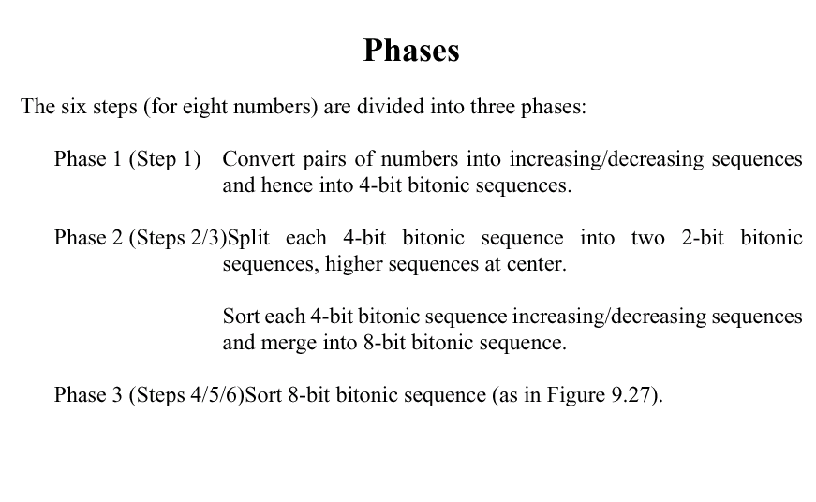

Slide 39
